Slide 1
Planning for first Facilitation group meeting

Slide 2
How we got here
Extensive consultation undertaken.
A full site, open space was chosen by the community (77% of the 677 submitters).
The Waitemata Local Board endorsed this result.
Board initiated the CLD process to achieve a design and budget to enable this outcome.
Waitemata Local Board will advocate for funding for the full site, open space.

Slide 3
This community-led design process
is to enable the Waitemata Local Board to realise the whole of site open space development.

Slide 4
Where do we start?
How will we run meetings/what is our process?
Permanent chairperson?
Voting or consensus?
How to share info to Comms groups and/or directly to the community?
Adding people to the groups - essential for Comms group.
Spokesperson to media enquiries - responsiveness and accuracy is important.
Reporting to WLB/or an invitation to attend – either actively or as an observer?

Slide 5
Deciding what CLD means for us
Examples provide ideas, but we decide our process and timeline.
We determine our considerations:
wellness
sustainability
educational opportunities
pace of development – modular, over 2-5 years?
funding ideas - alternate sources etc.
Who are the Stakeholders?
eg schools, parents, residents, users, businesses, faith communities, AT, education groups

Slide 6
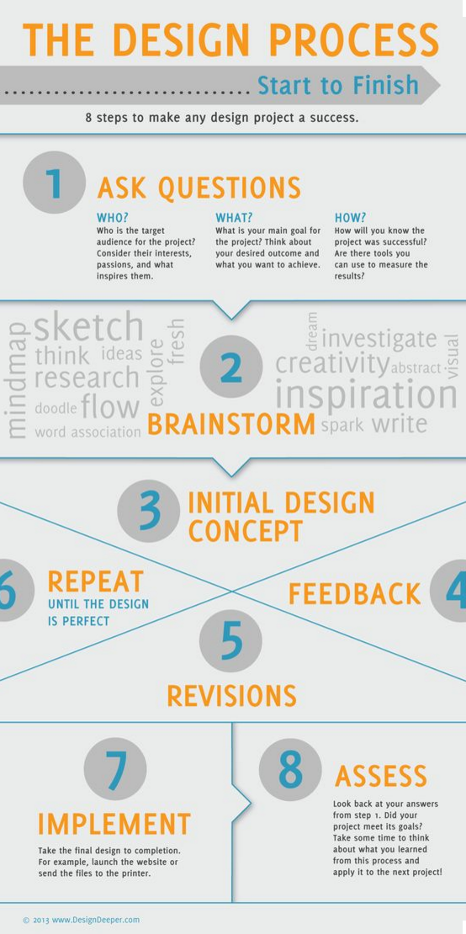
Potential pathway
Asset mapping →
Early ‘Design ideas’ →
Initial ‘Design brief’ →
Community selects preferred design components→
Draft designs options→
Community picks preferred design →
Design finalised and budgeted→
WLB then advocates for funding for this design option.

Slide 7
Asset mapping
Captures what is important to the community.
Captures what the community is aware they are missing.
May help prioritise what to include or find nearby and get provider like WLB to enhance.
May contain specifics but can also be completely ‘experience based’.
Desires for the space: feelings and needs.
Visions: what is an opportunity or needed.
We facilitate and collate information then send it back to the community for comment, modification and confirmation.

Slide 8
Asset Mapping → early ‘Design ideas’
Community responds with visions/ideas.
Educational groups are involved e.g. landscape architecture schools, design schools etc.
Competitions through the Comms team.
All ideas are useful, even impractical ones as we want ‘blue sky’ thinking at this stage.
Ask people to keep any difficult issues in mind and how they might be resolved.

Slide 9
Community selection
Collect, collate then get feedback
Ask community which (parts) of the ideas are appealing to them.
They create a ‘preference’ scale e.g.
art
sustainability
education
toilets…
Share results back to confirm with community

Slide 10
Draft designs
Many ways to do this eg
contract out to professionals
competitions
pro-bono etc.
Create 3 - 4 draft options depending on feedback lists?
Possibly cost/budget.
Development approaches eg
all at once, upfront cost
develop in sections or progressively?

Slide 11
Community final selection
Get feedback on:
Preferred design option
budget
Timing; modular/progressive versus all in one development.
Maybe start seeking public/private funding options (discuss with WLB once we get nearer this stage).

Slide 12
Final design and budget to WLB
Design realised.
Budget finalised and delivered to WLB.
Report on process/experience/results.
Explain our engagement system.
Possibly seek out sociology academic to get involved and do this as a paper so we get everything impartially captured?
Celebrate – event?

Slide 13
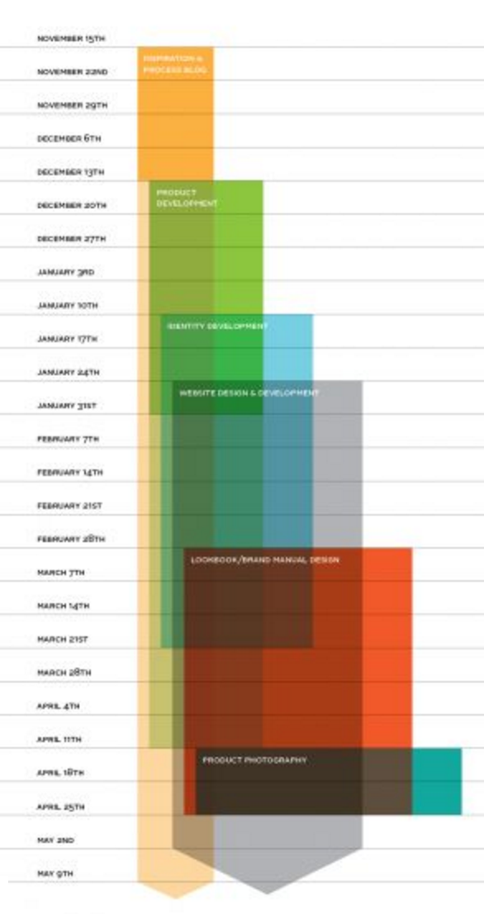
Possible timeline for this workflow
3 - 4 months for each stage would mean
12 - 18 months to complete the process?
Asset mapping → Early design ideas
Initial design brief → Selection of components
Draft design options → Community selects preferred option
Finalisation of design and budget
Presentations to WLB

Slide 14
Where do we start?
How will we run meetings/what is our process?
Permanent chairperson?
Voting or consensus?
How to share info to Comms groups and/or directly to the community?
Adding people to the groups - essential for Comms group.
Spokesperson to media enquiries - responsiveness and accuracy is important.
Reporting to WLB/or an invitation to attend – either actively or as an observer?

