Slide 1
A community-led design initiative
The whole-site open space at 254 Ponsonby Road

Slide 2
How did we get here?
A Boffa Miskell survey commissioned by the Auckland City Council in 2000, identified a shortage of open space in the Ponsonby area.
The site at 254 Ponsonby Road was purchased in 2006 to remedy this shortfall of open space.
Along with the wider area, the Ponsonby Road Masterplan offered options for the development of the 254 site.
Due to the amount of feedback from the Masterplan, a separate submission process for 254 Ponsonby Road was conducted.

Slide 3
The 254 Ponsonby Road public consultation
Ran for an extended 8 week period so everyone had the opportunity to have their voice heard.
Had more respondents than any other submission process besides Chamberlain Park.
Resulted in a clear and decisive preference by the community.

Slide 4
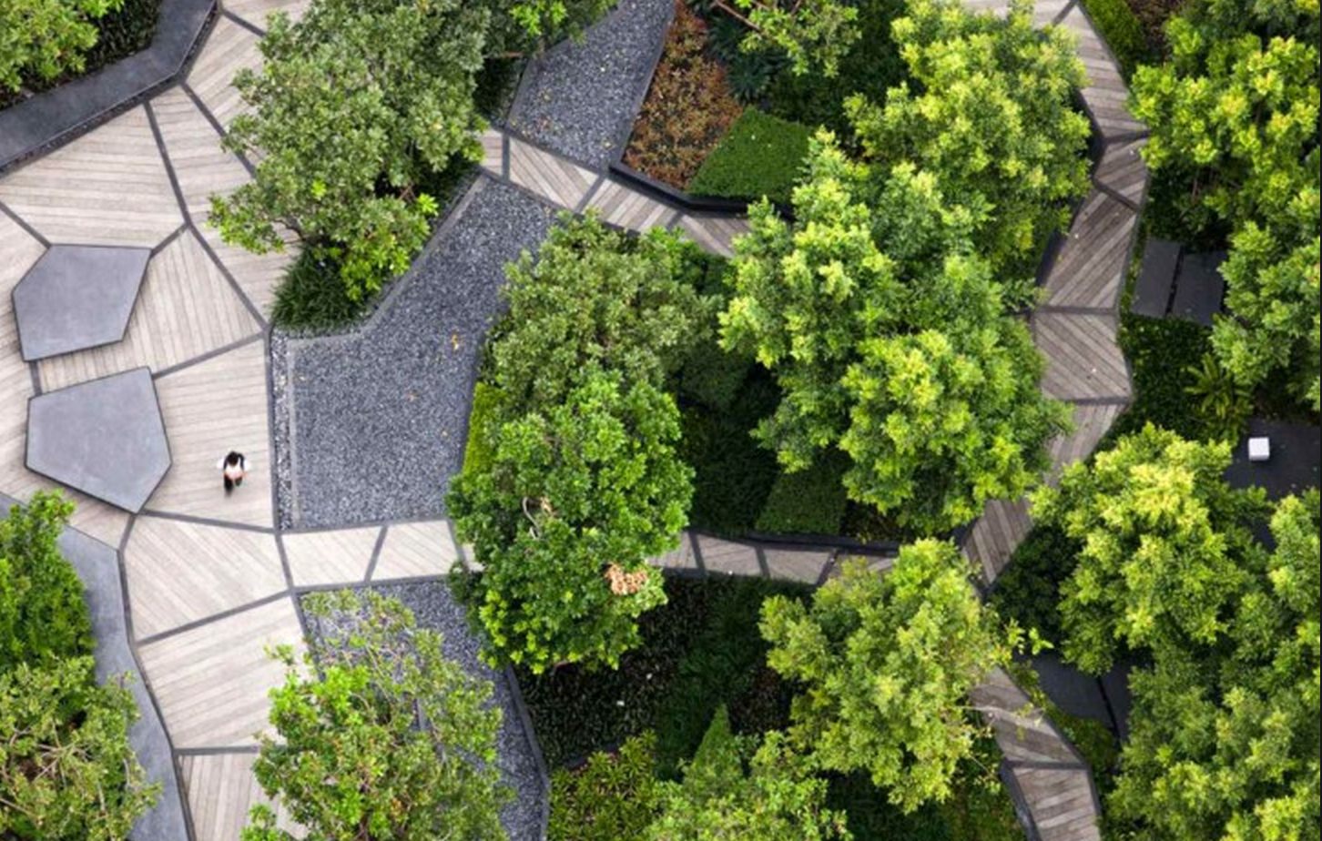
Results of the consultation
77% of all respondents chose the whole of site open space.

Slide 5
The consultation process also told us what things are important for many people…

Slide 6
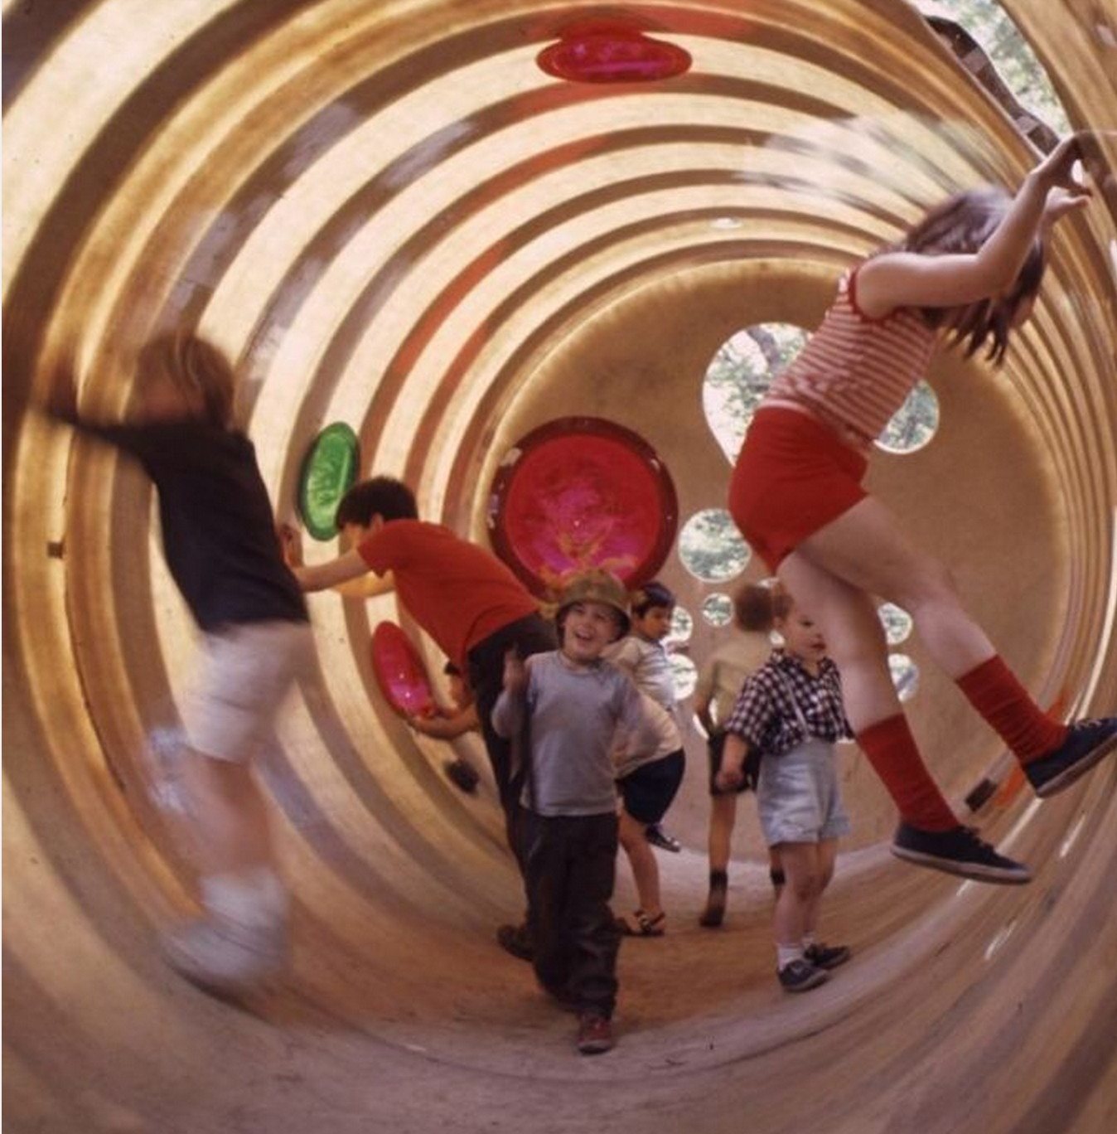
A playspace

Slide 7
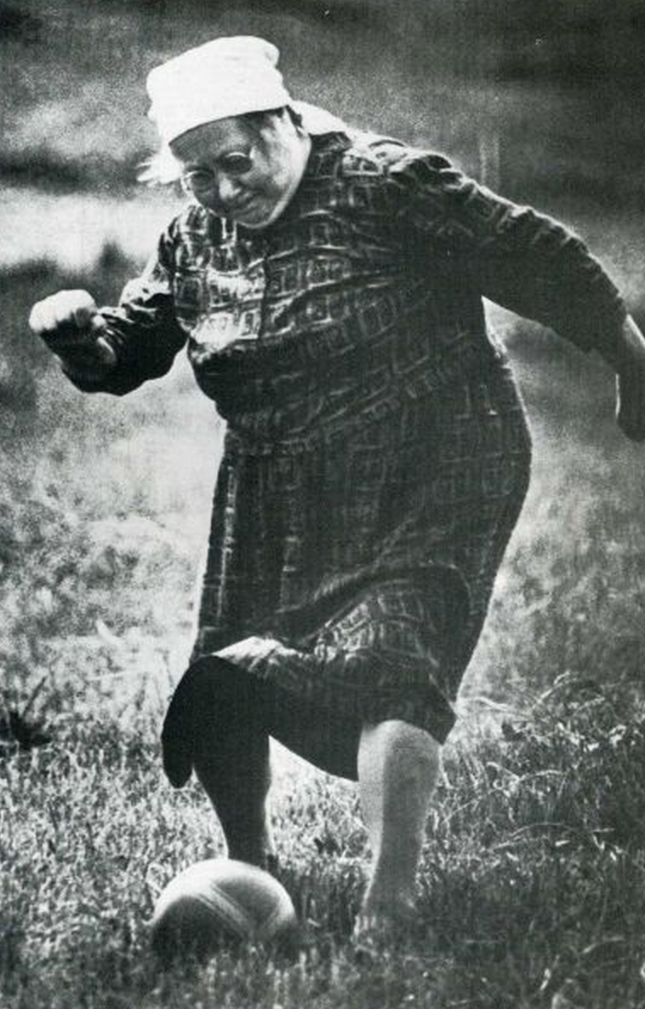
A kick about space

Slide 8
Shopping

Slide 9
Cafes/Dining

Slide 10
Markets

Slide 11
Public art
Tekoteko

Slide 12
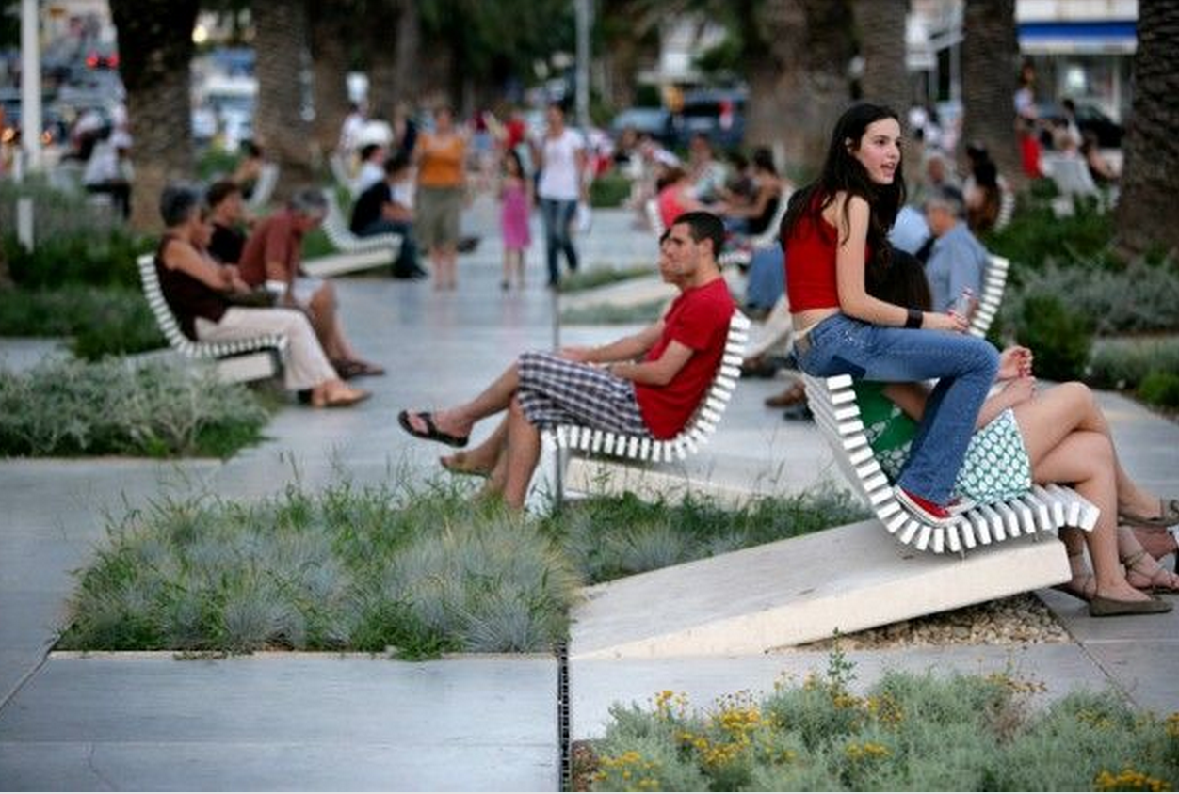
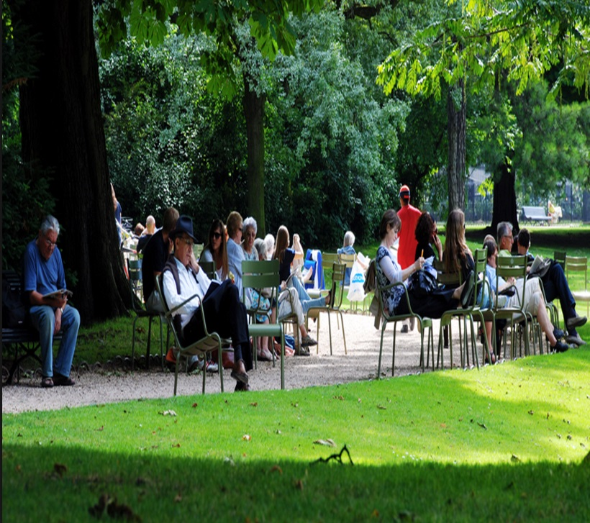
A place to sit and relax

Slide 13
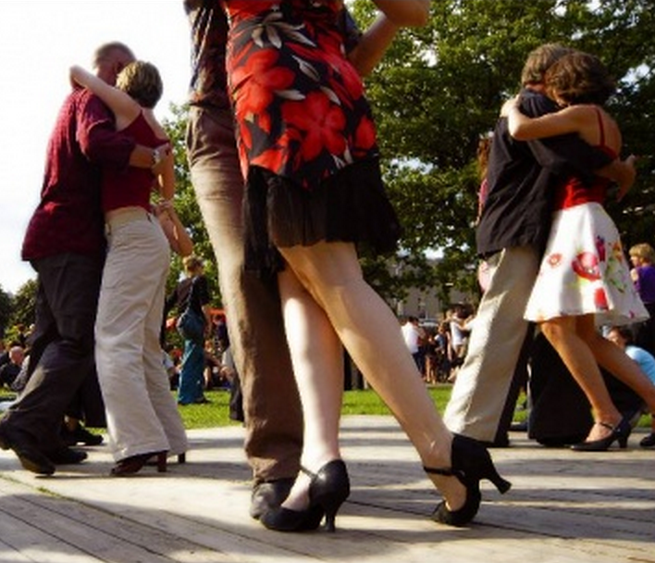
Events

Slide 14
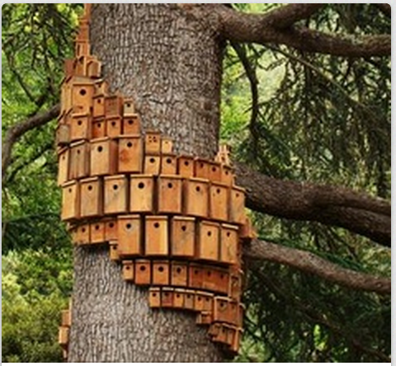
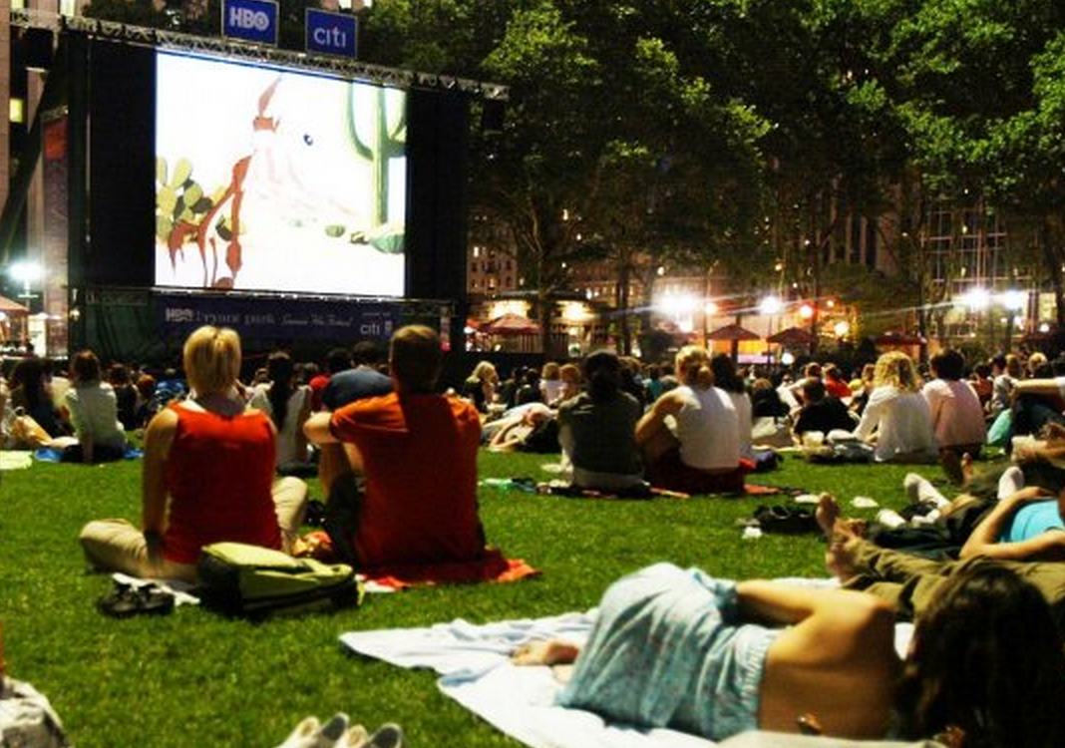
Specific comments

Slide 15
The whole of site open space is endorsed
The Waitemata Local Board endorsed the results of the submission process and resolved to advocate for funding for the whole of site open space.
A design and budget are required for the advocacy.

Slide 16
A Community-led design (CLD) process is born
The Waitemata Local Board has chosen to engage the local community to do the design and budget work via a community-led design process.
An ‘interim group’ was convened to begin the planning of the CLD process leading to the whole of site open space development.

Slide 17
So what is Community-led design?
led and project-managed by a community group or organisation.
is effectively involving local people in the decision-making process.
involves local people in decision-making throughout the design process, from visioning to implementation.
CLD projects have community involvement as an on-going process throughout the entire development of the project

Slide 18
Benefits
puts local people at the heart of making changes to their neighbourhoods.
can improve participation.
can strengthen people’s attachment to both place and to each other.
produces more sustainable solutions.

Slide 19
The core elements of CLD involve local people in
a collective vision for change.
a design brief informed by local knowledge.
decision-making throughout the evolution of the design process.
signing off key stages of the project.

Slide 20
How might you be a part of this?

Slide 21
The Facilitation group
The Facilitation group will coordinate the planning, information, development and direction of the whole-site open space design process.
Eventually, it will also create the budget for the design.
Specialists will be contracted as required.
Additional Council support will be available.

Slide 22
The Facilitation group will…
Design a process to collect ideas from a diverse range of people.
Work with those ideas.
Develop a brief.
Develop a design.
Develop a budget.

Slide 23
The Communication Networkers
Connect with and build on their existing networks.
share information and feedback to and from them.
enable many different people and groups to be represented
participate in a way that works for their groups.

Slide 24
The community-led design process is a new initiative.
It will be based on collaboration, fair play and the end goal of realising the whole of site community open space for 254 Ponsonby Road.

Slide 25
And now our work begins…

Slide 26
Join us

