Slide 1
Ponsonby Park
July 15 2015

Slide 2
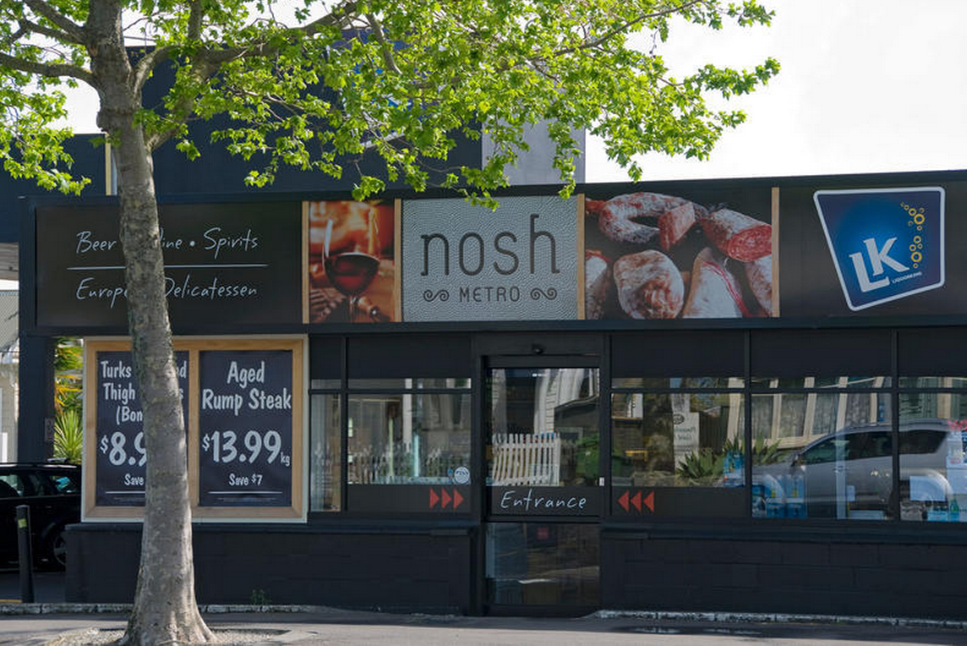
Background
Council purchased the site for a “Town Square” development
Submissions to the Ponsonby Road MasterPlan showed diverse views on the desired outcome
254 P’by Road was uncoupled from the Masterplan and a separate submission process carried out
This resulted in 77% support for a whole of site park development
Also provided information about what people would like to see included in the design

Slide 3
However
There is no budget currently available
No budget can be applied for until the design process has been completed
This has created an opportunity to try a Community Led Design process by involving the community to:
Develop a collective vision
Develop a design brief informed by the community
Make decisions throughout the evolution of the design process
Sign-off on the key stages of the design process
Time to put our thinking hats on..

Slide 4
The submission process told us about a few things about what people think is important or not so important…

Slide 5
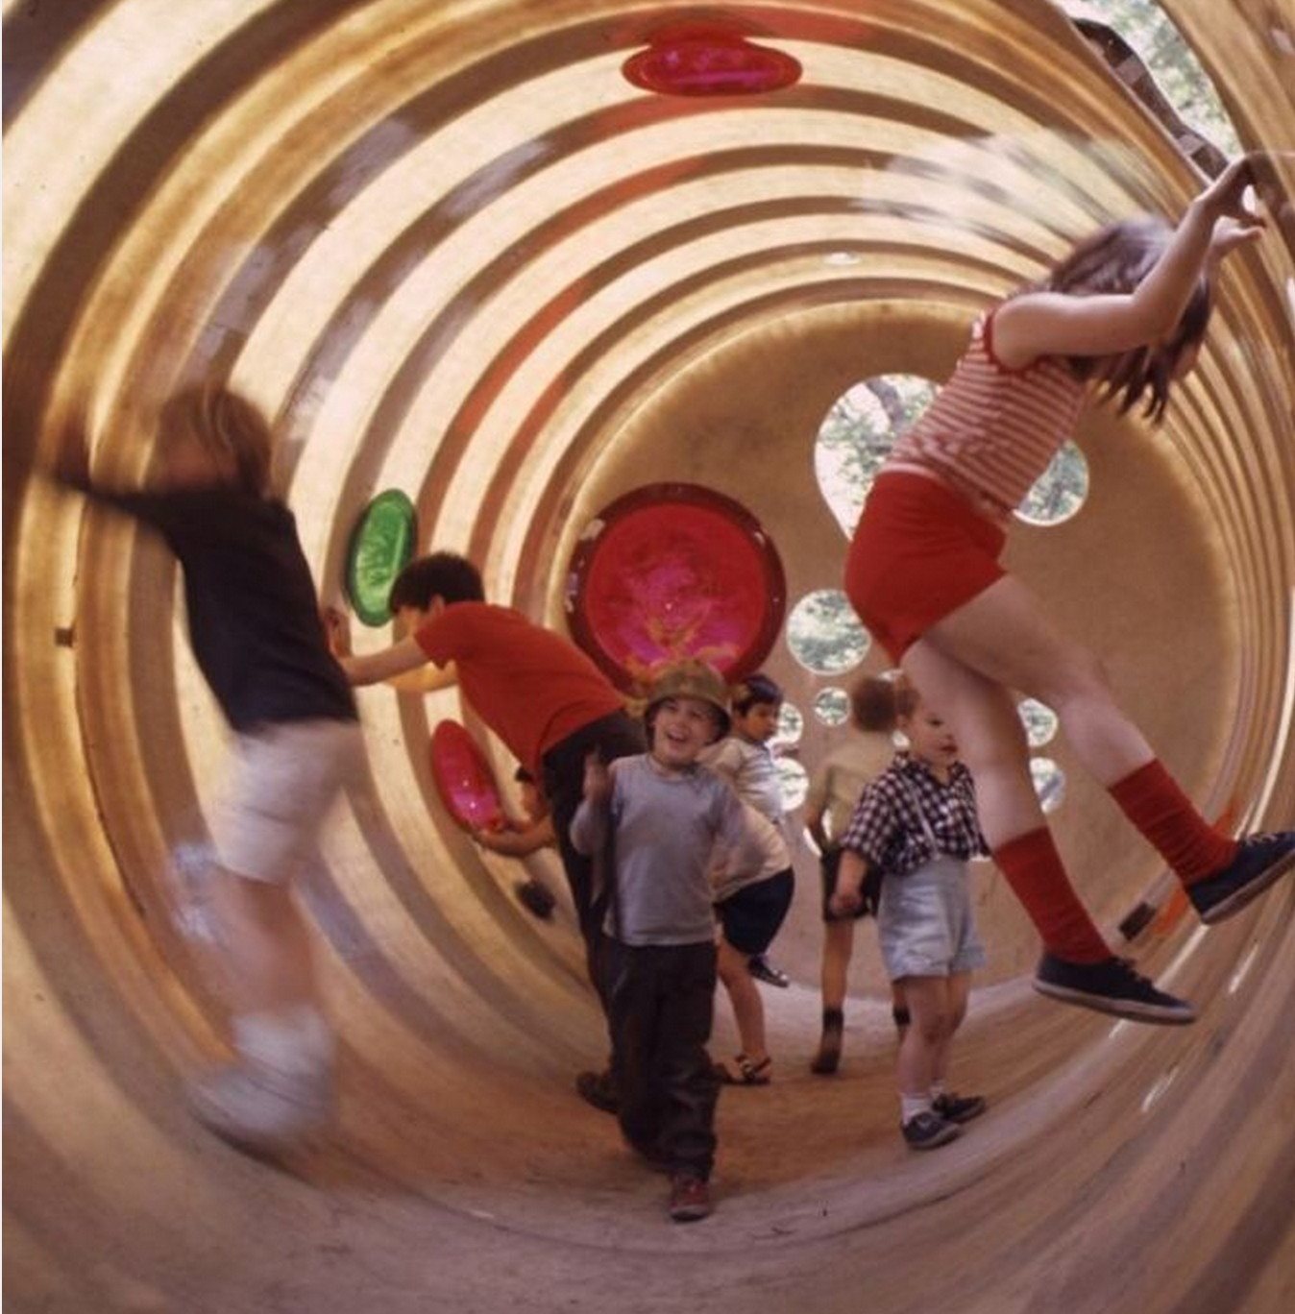
A playspace

Slide 6
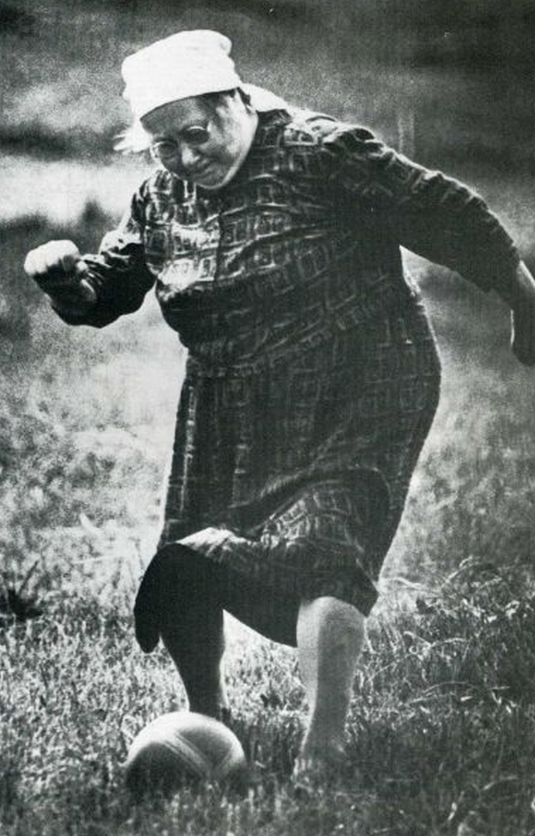
A kick about space

Slide 7
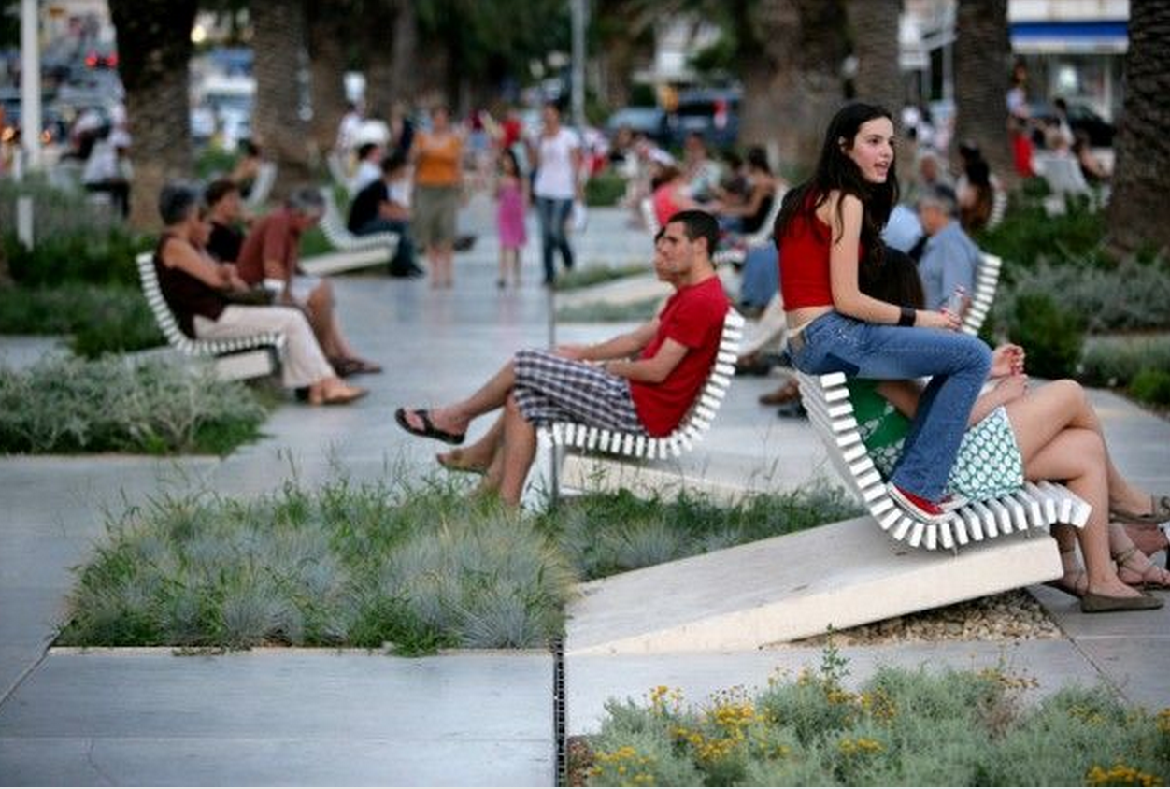
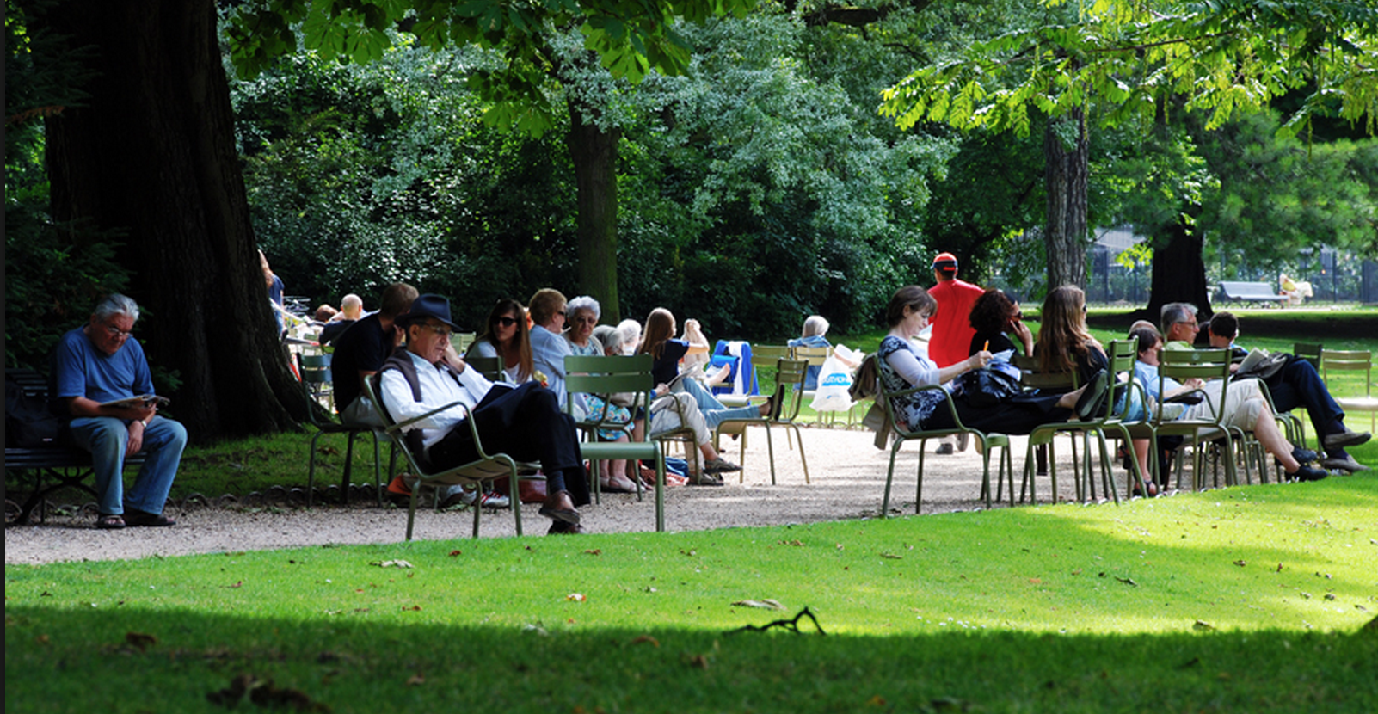
A place to sit and relax

Slide 8
Events

Slide 9
Shopping

Slide 10
Cafes/Dining

Slide 11
Markets

Slide 12
Public art
Tekoteko
Tekoteko

Slide 13
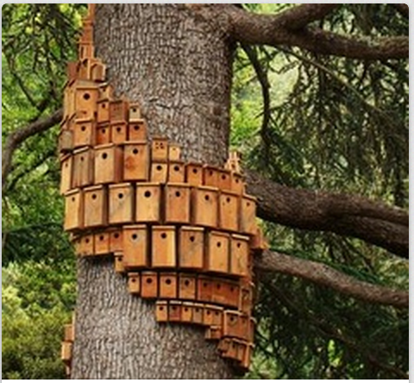
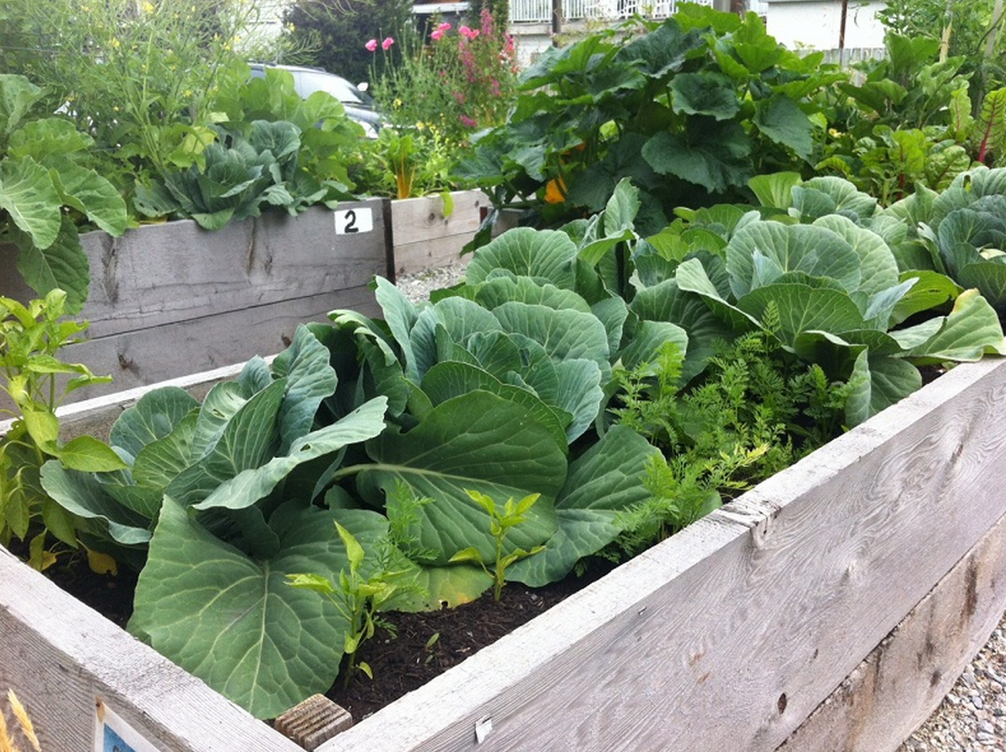
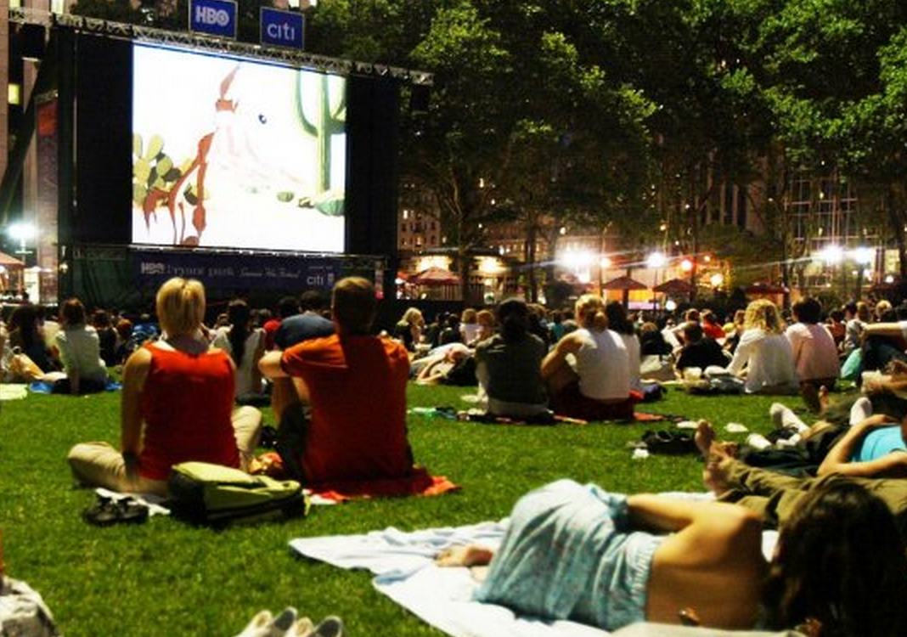
Specific comments

Slide 14
And now our work begins…

