Slide 1

Community-led Design Workshop
Ponsonby Park at 254 Ponsonby Road

Slide 2

Our History
Boffa Miskell survey in 2000.
Site purchased in 2006.
Ponsonby Road Draft
Masterplan, July 2013.
Site specific consultation, closed December 2014.
WLB resolution to support a ‘whole of site park’ via a CLD initiative.
Interim group inaugurated the Facilitation group.
The CLD Facilitation Group began work on 14th April, 2016.

Slide 3
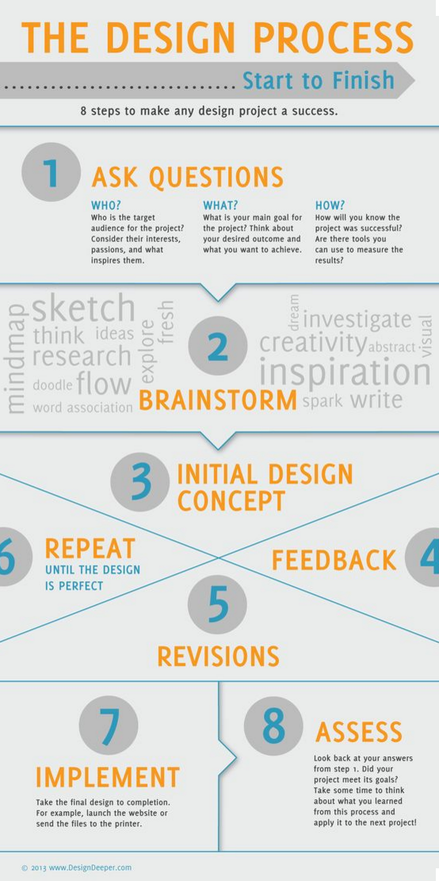
CLD Facilitation Group pathway to date
Analysis of WLB Submission results.
1st survey asked the community what they would like for the whole of the site open space.
Analysis of these results.
Creation of the Initial Design Brief.
Invited students & designers to submit design ideas based on this brief.
2nd Survey asked the Community to select their preferred components from these designs.
From this feedback we finalised The Design Brief.
Invited Designers to submit draft concept designs.
3rd Survey asked the Community to select their preferred design and give feedback.
The Chosen design, with budget outline was presented to WLB April 2017.
Workshop these results today.

Slide 4
People involved in our CLD process
1243 from initial petition
The WLB had received 676 responses from their initial 254 P’by Road submission process.
1st CLD consultation had 190 respondents.
2nd CLD consultation had 115 respondents.
3rd CLD consultation had 1208 respondents.
Significant & sustained engagement.

Slide 5
Voting Results - # 1 LandLAB chosen

Slide 6
Graph of community’s priorities

Slide 7
Analysis: Priorities

Slide 8
Analysis: design consistencies

Slide 9
Analysis: design differences

Slide 10

CLD becomes CLI moving forward to implementation of the park design

Slide 11
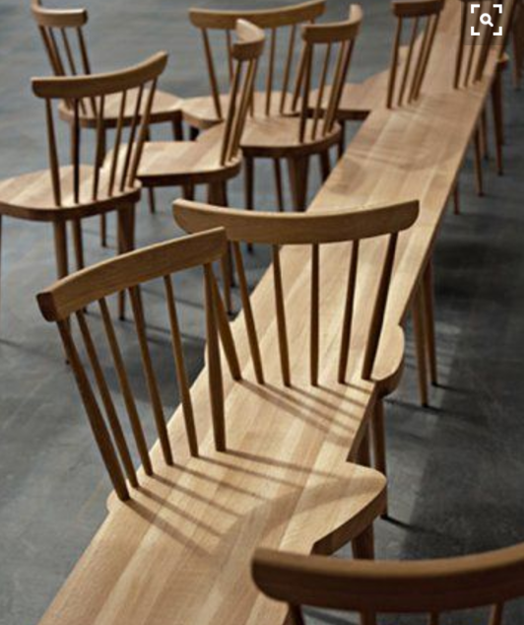
Ongoing Community involvement
Retain the community engagement in the process.
Regular monthly meeting to enable reporting back to the community via the CLI group.
Key point-of-contact person within Council for the CLI group.
Timeline for park development.
Strategy to find funding.

Slide 12
Create a pop-up park – asap
Release a portion of the front of the site to the community - as per Auckland Council Parks and open space acquisition policy that states:
“After Auckland Council has acquired land for parks and open space, public access will be provided as soon as practicable so the community can enjoy the new park or open space.”

Slide 13
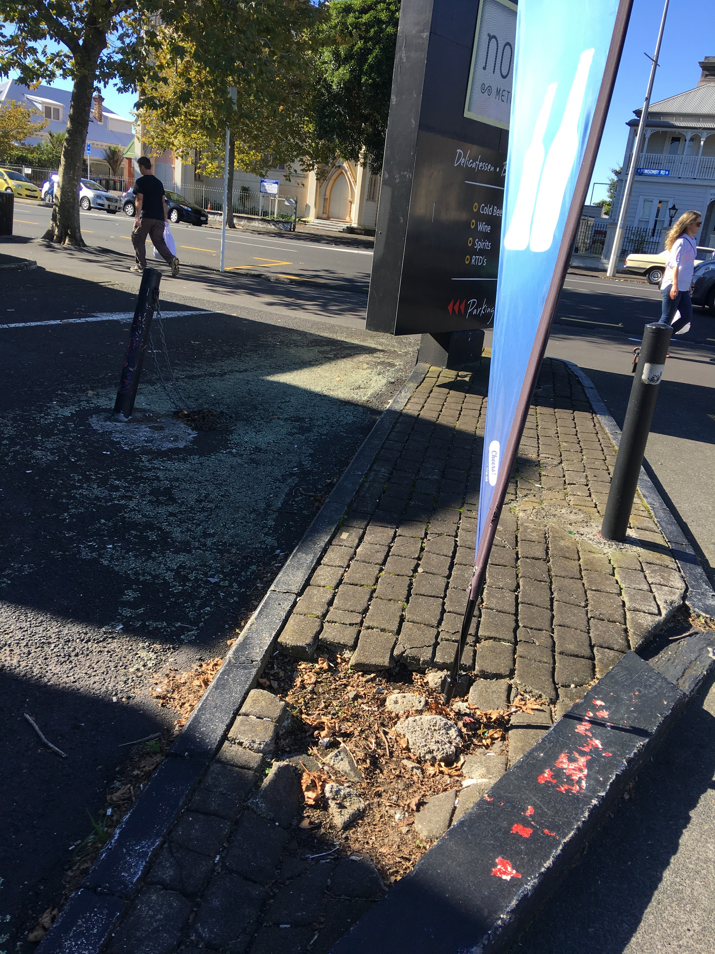
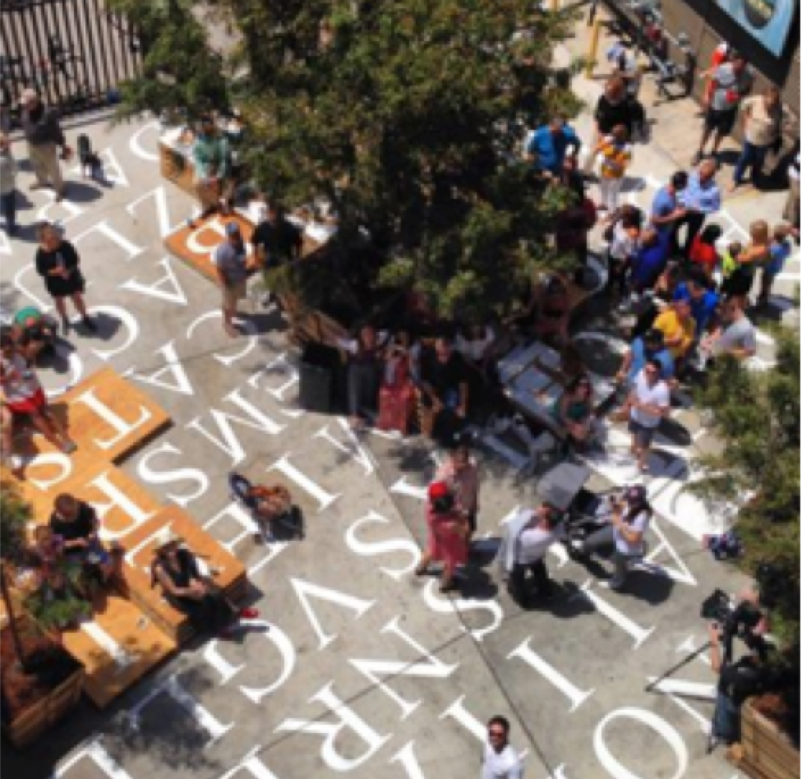
Maintain and reward the Community’s engagement
An onsite noticeboard
An on-site suggestion box
The numbering of the site - 254
An accessible area for the people to ‘Rest and Relax’ to enjoy some much desired open green space.
Beautify our park site.

Slide 14
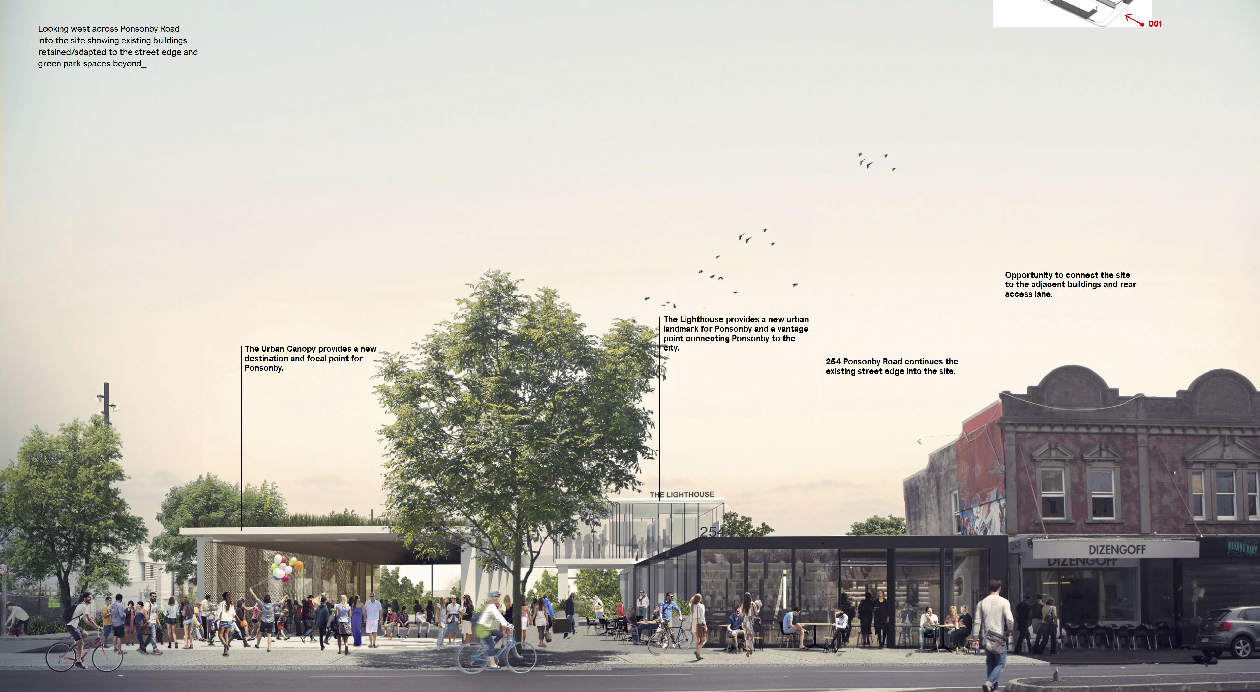
Ponsonby Park – let’s make it happen

Slide 15
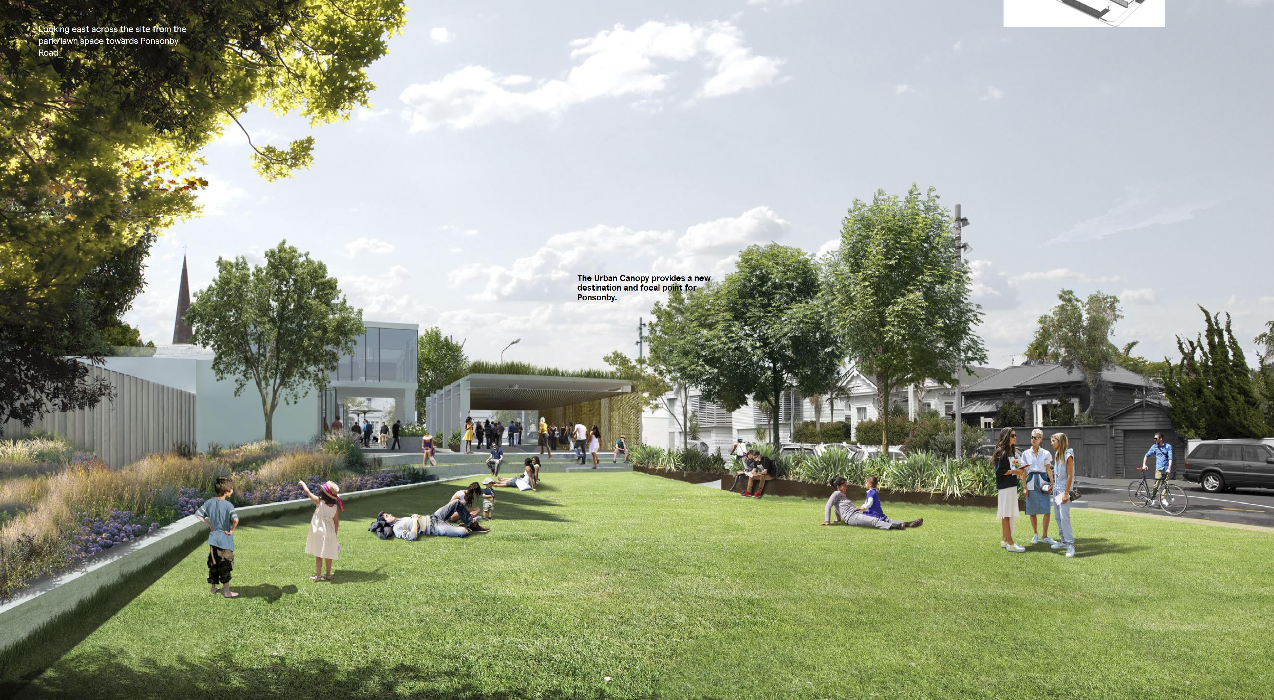
An Urban Green space for Everyone

